Slide 1
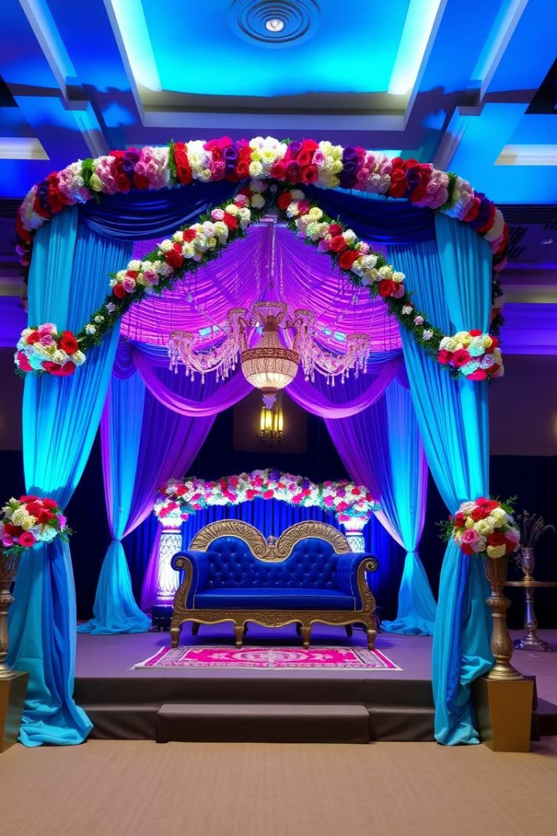
BookMyMandap: Simplifying Venue Booking
BookMyMandap is an innovative online platform that connects users with Mandap venues for weddings and events. It aims to streamline the entire booking process, making it simple, fast, and organized for both users and providers. By offering a user-friendly interface, the platform facilitates seamless venue discovery and reservations, saving time and effort. Whether you're planning a grand wedding or an intimate event, BookMyMandap empowers you to find the perfect venue with ease and confidence.

Slide 2
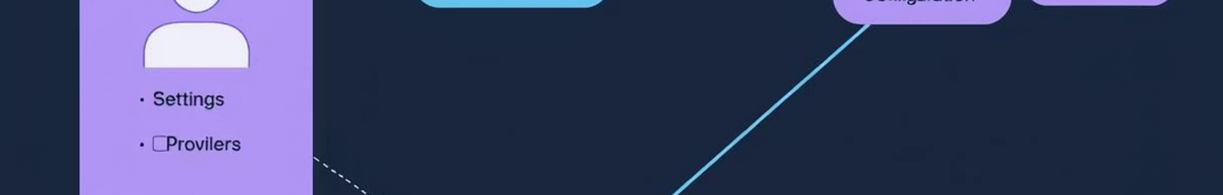
Use Case Diagram: BookMyMandap
This Use Case Diagram illustrates the interactions between the three main actors of BookMyMandap: the User, Provider, and Admin. Users can search for Mandaps, view detailed listings, make bookings, manage their reservations, and provide feedback. Providers have control over listing Mandaps, updating venue details, managing bookings, and analyzing their business. Admins oversee the entire platform by managing users, providers, Mandap listings, and generating vital operational reports to ensure smooth functioning.
User
Provider
Admin
Search Mandaps
List Mandap
Manage Users
View Details
Update Details
Manage Providers
Book Mandap
Manage Bookings
Manage Mandaps
Manage Bookings
View Analytics
Generate Reports
Provide Feedback

Slide 3
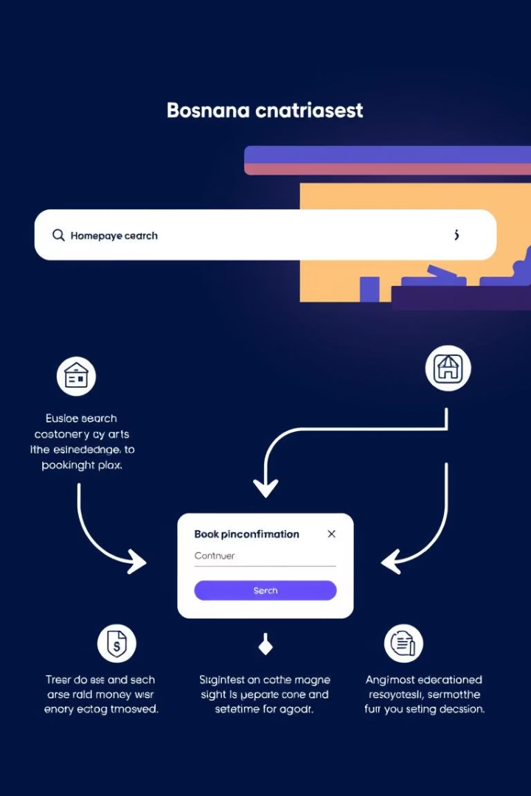




User Flow Diagram: User Booking a Mandap
The user journey begins when visitors land on the BookMyMandap homepage, where they can easily search for Mandaps by location, date, and capacity. They can filter and sort search results to narrow down options. Once a suitable Mandap is found, users view detailed information including photos, amenities, and pricing. After verifying availability, users proceed to book, complete payment, and receive confirmation, making the entire process smooth and transparent.
Search Mandaps
Using filters like location, date, and capacity
View Details
Explore photos, amenities, and pricing
Book Mandap
Check availability and make payment
Booking Confirmation
Receive booking details instantly

Slide 4
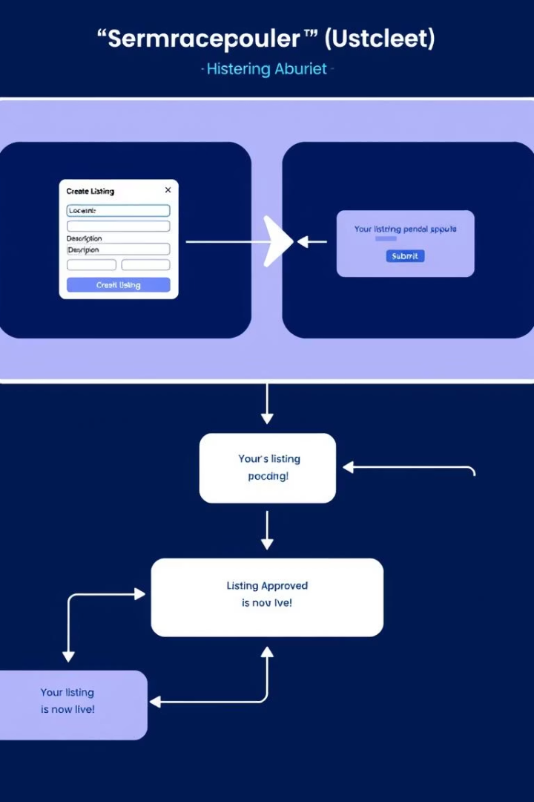
User Flow Diagram: Provider Listing a Mandap
Providers begin their process by logging into their accounts on BookMyMandap. They access the "List Mandap" section where they enter comprehensive details such as location, capacity, available amenities, and upload photos. Providers then set pricing and availability before submitting the listing for admin approval. Once approved, the Mandap becomes live and searchable by users, enabling providers to expand their reach and grow bookings efficiently.
1
Provider Login
Secure access to provider dashboard
2
Enter Mandap Details
Location, capacity, photos, amenities
3
Set Pricing & Availability
Flexible options for event dates
4
Admin Approval
Quality check and listing activation

Slide 5
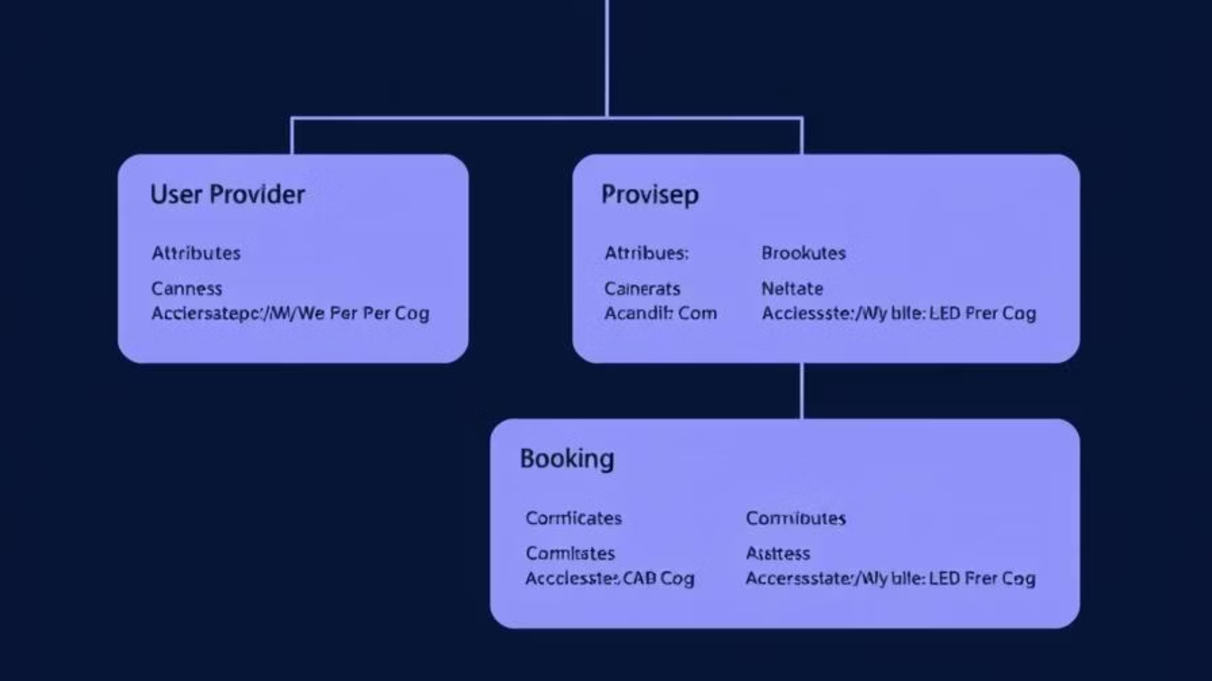
Class Diagram: Core Entities
The Class Diagram defines the core entities that form the foundation of BookMyMandap’s system. Key classes include User, Provider, Mandap, and Booking. Each entity contains essential attributes such as IDs, contact info, and relationships that enable interactions between booking histories, venue listings, and reservation statuses. This robust structure supports scalability and ensures data integrity while simplifying maintenance and feature additions.
User
Provider
Mandap
Booking
UserID
ProviderID
MandapID
BookingID
Name
Name
ProviderID
UserID
Email
Email
Location
MandapID
Password
Password
Capacity
BookingDate
Booking History
Mandaps Listed
Amenities
EventDate
Pricing
Status
Availability
Photos

Slide 6

Entity-Relationship Diagram (ERD)
The Entity-Relationship Diagram graphically represents the database structure for BookMyMandap. It details the entities—User, Provider, Mandap, and Booking—along with their attributes and the relationships between them. For example, Users can have many Bookings, and Providers can manage multiple Mandaps. This visual guide clarifies data organization essentials, ensuring efficient querying, data consistency, and smooth platform operation.
User
1..*
Booking
Provider
1..*
Mandap
Mandap
1..*
Booking

Slide 7
System Architecture Diagram
BookMyMandap's architecture combines modern frontend technologies like React or Angular for a responsive user interface with robust backend frameworks such as Node.js or Python for business logic. The platform relies on relational databases like PostgreSQL or MySQL for structured data storage. Deployment on cloud services such as AWS ensures scalability and reliability. An API Gateway manages all client-server communications, securing and streamlining API requests across the system.
Frontend
Backend
Database
Cloud & API
React or Angular for an interactive UI
Node.js or Python handles application logic
PostgreSQL or MySQL for data persistence
AWS cloud infrastructure with API gateway for security and scalability

Slide 8
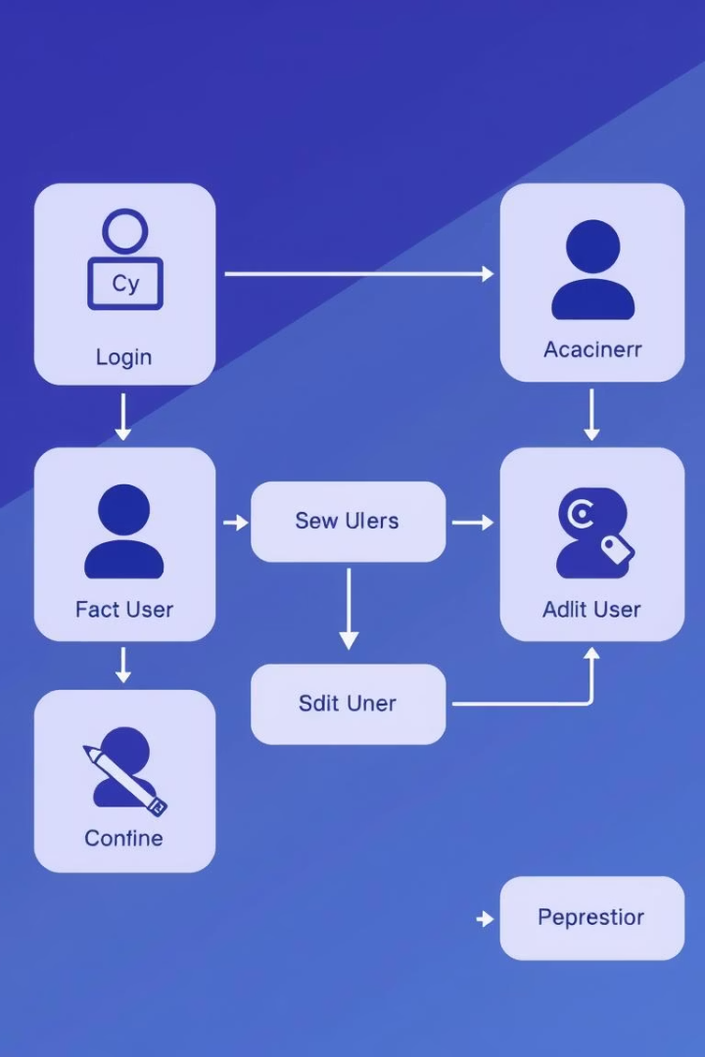
Activity Diagram: Admin Managing Users
The admin starts by logging into the BookMyMandap admin panel and selecting the “Manage Users” option. Admins can view the user list, select individual users, and perform actions such as editing details, deactivating, or deleting accounts. Confirming changes updates the system immediately. This workflow provides admins the control needed to maintain accurate user records and ensure platform security.
Admin Login
Secure access to the admin panel
Select Manage Users
Navigate to user management section
Edit or Deactivate User
Modify user details or deactivate accounts
Confirm Changes
Save updates in the system

Slide 9
Sequence Diagram: Booking a Mandap
This sequence diagram breaks down the interactions during a Mandap booking. A user searches for Mandaps, triggering the system to fetch matching venues from the database. Upon selection, availability is confirmed and payment is processed through a payment gateway. A successful transaction results in the booking record being saved, with the user promptly receiving confirmation. This controlled sequence ensures a smooth and secure booking experience.
Step 1
Step 2
Step 3
Step 4
User searches for Mandaps
System retrieves and displays results
User selects Mandap and places booking
System checks availability and processes payment

Slide 10
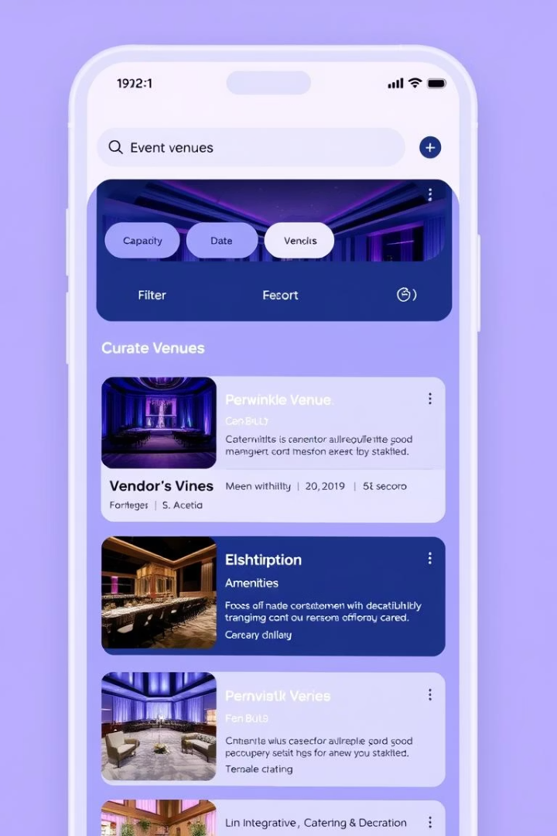
BookMyMandap: Future Enhancements & Conclusion
Looking ahead, BookMyMandap plans to enrich the platform by introducing user reviews and ratings to build community trust. Enhanced search filters will allow selections by theme or style, tailoring search results further. Integration with vendors such as catering and décor will provide comprehensive event solutions. A mobile app is under development to offer convenience on the go. Together, these improvements will continue revolutionizing wedding and event venue bookings.
User Reviews & Ratings
Foster community feedback and trust
Advanced Filters
Search by wedding themes and styles
Vendor Integrations
Expand services with catering and décor options
Mobile Accessibility
Develop a mobile app for convenience

